Slide 1
Classifying Kepler Telescope Data
Matthew E. Parker
August 23, 2019

Slide 2
The Data
Cumulative Observational Data from NASA’s Kepler Space Telescope Mission (2009-2018)
9,564 observations/KOIs (Kepler Objects of Interest)
4723 candidate exoplanets
2,662 confirmed exoplanets to date!
20 features / variables
The Problem
Develop a Model to Classify Observations

Slide 3

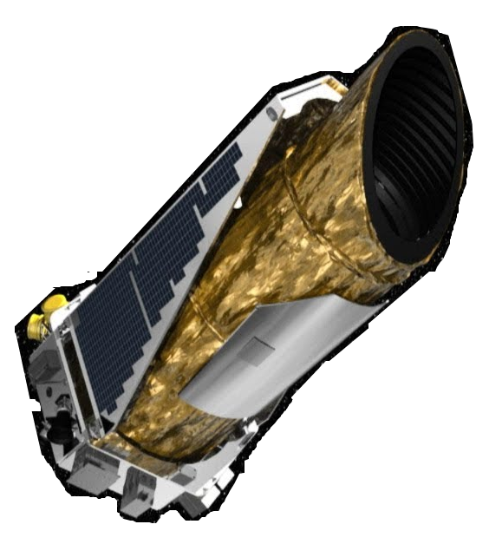
Obtaining the Data
Obtained data from public access NASA Kepler API
Merged data from “Objects of Interest” and “Confirmed Exoplanets” data sets

Slide 4
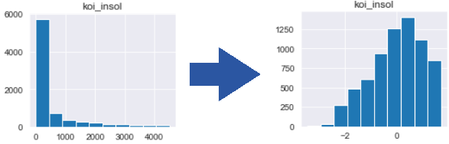
Scrubbing the Data
Removal of:
outliers
unimportant features
non-observational features
observations with missing data
Transformation / Normalization / Scaling of Data

Slide 5


Exploring the Data
Examined correlations between features
Removed redundant features
Engineered features to merge similar (but not redundant) features
Star Radius
Star Diameter
KOI orbit period
KOI speed
KOI mass
KOI_mass_speed_period_feature

Slide 6
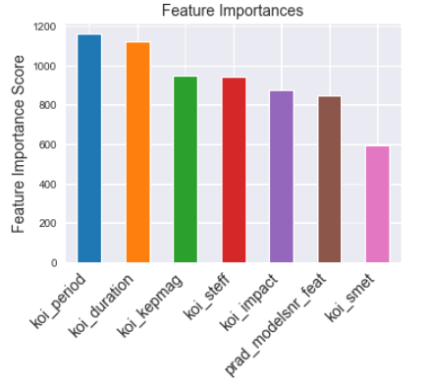
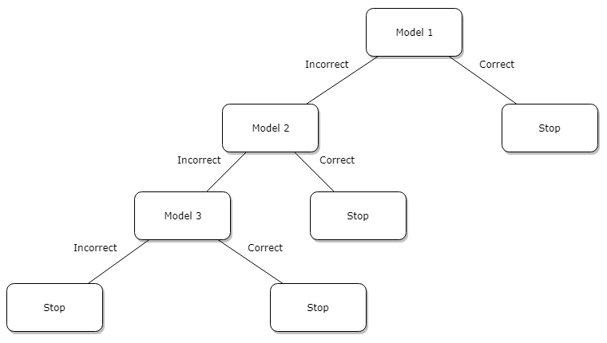
Modeling the Data
Attempted several variations of XGBoost and Support Vector Classifiers, even tuning parameters and chaining and stacking various models.
Best accuracy (83%) came from the default SVC (Support Vector Classifier) parameters.
Example of
Model Chain:

Slide 7
Interpreting the Data

Slide 8
Thank You
Aim for the stars!

